Slide 2
Week 6
The final item needed on our pilgrimage is food and nourishment. On walking pilgrimages, the food is often quite simple, traditional to the places pilgrims are visiting, but it helps to sustain them, so they have enough energy to walk. One of the important pilgrimages in the Bible took place in the last week of Jesus’ life. Watch the video on the next slide to find out more.
Matthew 26 As they were eating, Jesus took some bread and blessed it. Then he broke it in pieces and gave it to the disciples, saying, “Take this and eat it, for this is my body.” And he took a cup of wine and gave thanks to God for it. He gave it to them and said, “Each of you drink from it, for this is my blood, which confirms the covenant between God and his people. It is poured out as a sacrifice to forgive the sins of many. Mark my words—I will not drink wine again until the day I drink it new with you in my Father’s Kingdom.” NIV
More Reading: John 13

Slide 3
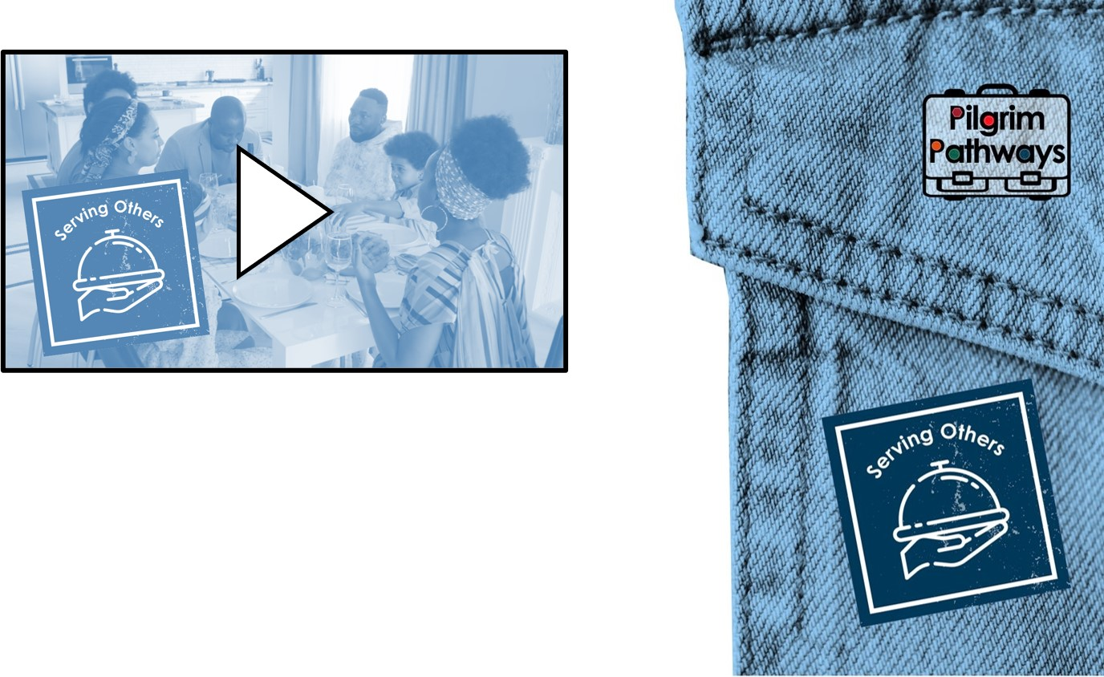
Questions
Who do you connect with during your mealtimes?
How could you use that mealtime differently?
What activities or actions do you do that show your care for others?

Slide 4
Have you enjoyed the Pilgrim Pathways at Lent resource?

