Slide 2
Week 5
When people take part in walking pilgrimages, they need to find shelter at night, some will camp, some will book places to stay along the way. Sometimes during a day’s walking, people will need to take shelter or find a place of safety. Our fifth item is shelter. Watch the video to find out more about the shelters found on Lindisfarne in Northumberland, also known as Holy Island, and where we can take shelter during the storms of life.
Psalm 46:1-3 God is our refuge and strength, an ever-present help in trouble. Therefore, we will not fear, though the earth give way and the mountains fall into the heart of the sea, though its waters roar and foam and the mountains quake with their surging. NIV
More Reading: Matthew 8:23-27

Slide 3
Questions
Who or what helped you when life has felt stormy?
Have you tried something new, outside your comfort zone?
What did you learn about yourself during this time?

Slide 4
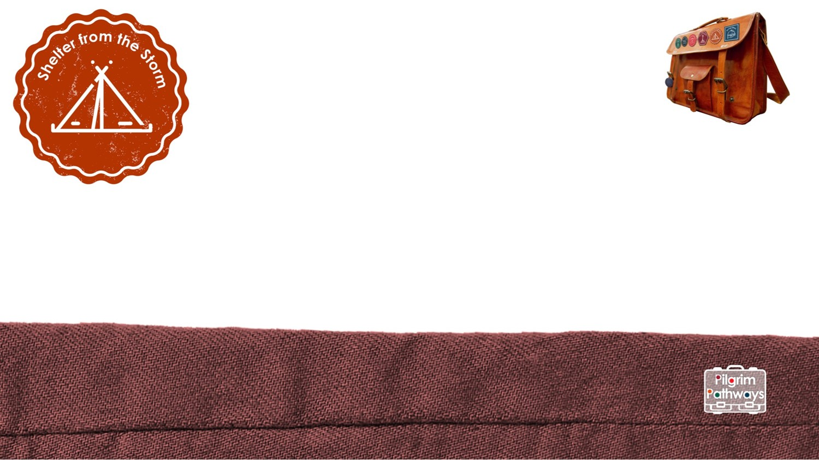
Challenges:
Discover Find out about someone who has shown resilience during difficult times: Nelson Mandela, Bethany Hamilton, Martin Luther King. What helped them carry on trying? How can their story encourage us? | Reflect Build a wall of resilience bricks. Cut brick shapes in paper. Write on each of them times when you have faced something new or have been worried, but still achieved it and developed new skills or bravery. Think of who has encouraged you and add these moments to your wall.
Create Find a box and some lollipop sticks and make a shelter like those on Holy Island. On the inside of the walls write or draw things that you shelter from. On the outside write or draw people or things that help you when you are scared and need to shelter. | Act Try out a new activity or hobby, perhaps without the security of your circle of friends. Take this as an opportunity to stretch yourself. Support or raise awareness for a homeless charity that offers people shelter.
Prayer
Jesus, friend and saviour, be with us in the storms of life. Encourage us to step out of our comfort zone. Help us to be open to new things and to grow in confidence. Help us to see ourselves as you see us, full of potential for good. Amen.

