Slide 2
Week 3
Going on a journey can be a great transforming experience, but it can also be difficult. It can be physically tough and sometimes even difficult mentally and emotionally. The third item to help us on our journey is a first aid kit. Watch the video on the next slide and find out what can be a helpful first aid kit as we pilgrimage.
Psalm 28 Praise be to the Lord, for He has heard my cry for mercy. The Lord is my strength and my shield; my heart trusts in Him, and He helps me. My heart leaps for joy, and with my song I praise Him.
More Reading: Luke 8:40-56

Slide 3
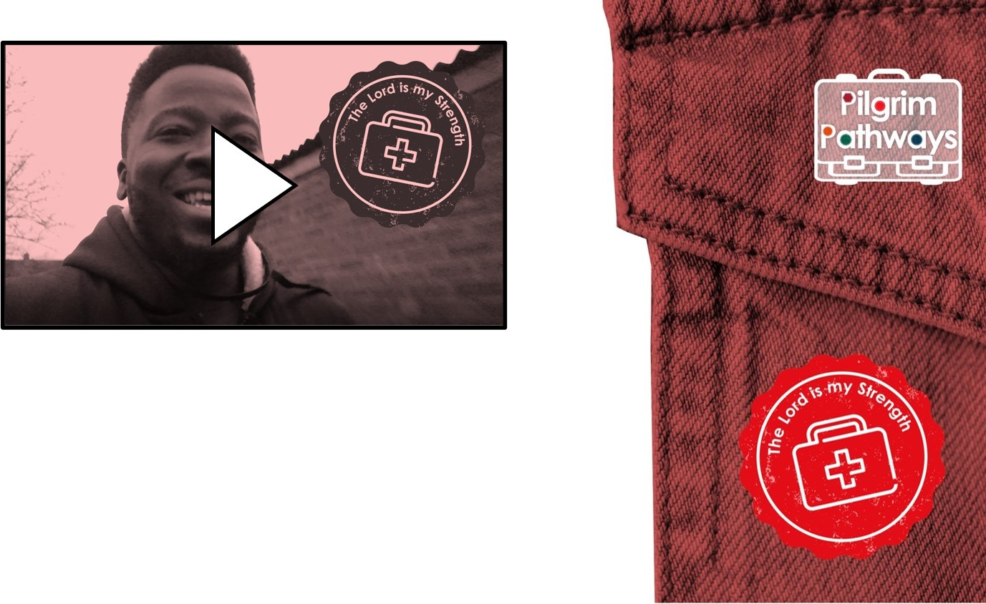
Questions
If the journey of life becomes hard, who can you turn to for support?
Who offers a good listening ear?
Who could you recommend to a friend that might be struggling?

Slide 4
Challenges:
Discover Research charities and organisations that can help children and young people with their physical or mental health. Design a poster or information that can be used on the school website to show links to good support. | Reflect Try a finger labyrinth journey. Use this as a time to think, reflect or to pray about any challenges you are facing. What might help you face these challenges? Who could you talk to about them?
Create Read Psalm 121. If you know of someone who needs some reassurance, write or print it out for them. Create a card or bookmark with words of encouragement to give to someone who is struggling. | Act Create a motivation or encouragement corner in school. Fill this with activities, inspiring quotes or prayers that will help others feel supported Take a walk with a friend or family member. How could you encourage each other on this journey?
Prayer
God of all time, stay close to us as we journey. When our feet and our hearts are weary, we ask for your protection and comfort. When we laugh and enjoy the sunshine, help us continue to support and encourage others. We ask that you give us good friends for the journey and help us to be good friends to others. Amen.

