Slide 2
Introduction
Many Christians use the time of Lent for reflecting on their faith and the Easter story. Some people choose to go on a pilgrimage, a walking journey, that gives them space to reflect and think about their relationship with God and how they can follow Jesus’ example by loving, giving and being compassionate.
With 6 weeks of content, Pilgrim Pathways will take pupils on a pilgrimage journey through Lent, looking at items that are important on a walking pilgrimage. Each week will focus on a different item beginning with a lamp and followed with a map, first aid kit, walking stick, shelter and finally food & drink. Pilgrim Pathways will help pupils explore how these items symbolise ideas that can help them when facing challenges in their personal life journey. They are designed to encourage reflection and practical actions that can support pupils’ wellbeing and happiness.

Slide 3
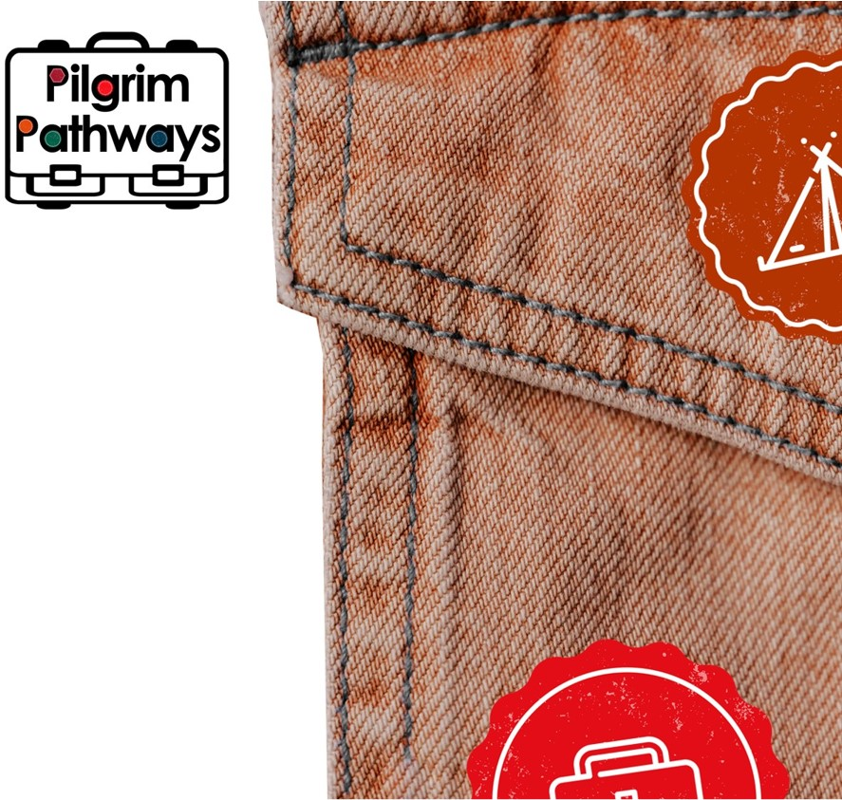
Introduction
Each week, the resource includes:
An introduction to the pilgrimage symbol
Bible links
A short video reflection
4 practical challenges
A closing prayer
The resource can be used for collective worship in school or church settings. Activities and challenges are suitable for KS2 and KS3 but can be adjusted for use with KS1 and KS4 pupils.

Slide 4
Week 1
Many Christians use the time of Lent for reflecting on their faith and the Easter story. Some people choose to go on a pilgrimage, a walking journey, that gives them space to reflect and think about their relationship with God and how they can follow Jesus’ example and be loving, giving and compassionate to the world around them.
Walking Pilgrimages are often quite simple, and people carry very little, but there are some key items that help people to find their way. Our first item today is a lamp. Watch our short video on the next slide, explaining what pilgrimage is and how a light can help us during our Lent journey.
1 Peter 2:9-11 But you are chosen people. You are the King’s priests. You are a holy nation. You are a nation that belongs to God alone. God chose you to tell about the wonderful things he has done. He called you out of darkness into his wonderful light. At one time you were not God’s people. But now you are his people. In the past you had never received mercy. But now you have received God’s mercy. Dear friends, you are like visitors and strangers in this world… So live good lives. International Children’s Bible
More Reading: Matthew 4:17-20

Slide 5
Questions
Who or what brings light into your life?
How can they help you on life’s journey?
How and where can you bring light into the lives of others?

Slide 6
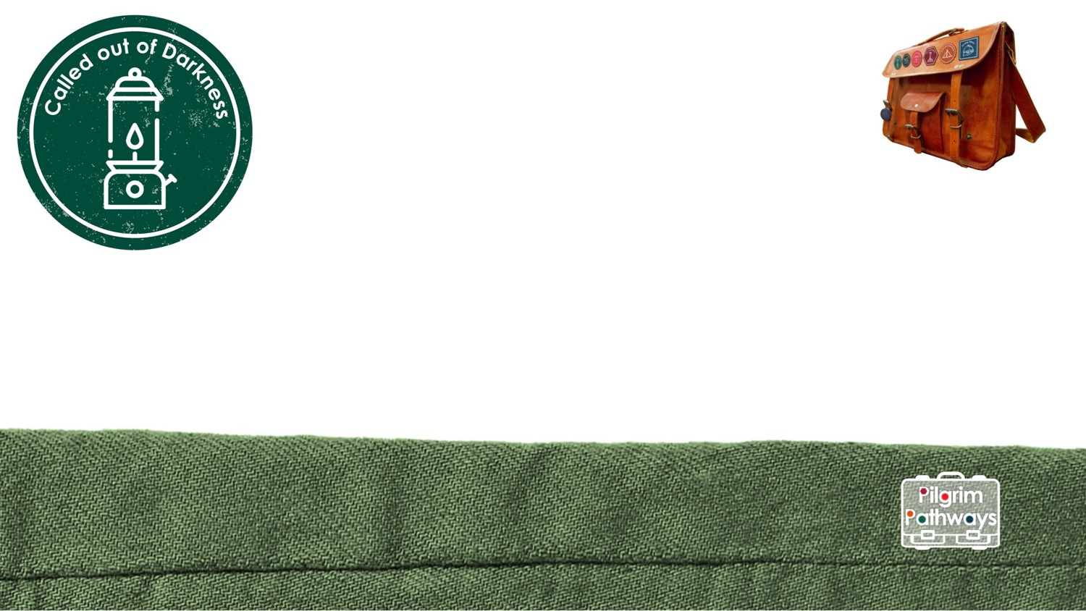
Challenges:
Discover Research the story of ‘The Lady of the Lamp’. How did she bring light into the darkness of war? What can you learn from her example? | Reflect Try a finger labyrinth journey. Use this as a time to think, reflect or to pray about bringing light to the world. Find the worksheet here.
Create Make your own lamp. Use coloured film for the windows and place an LED tealight inside to let the light shine out. On the outside write character virtues that a person needs to bring light in a dark place. | Act Who has been an important light in your life? How could you say thank you to them? Where can you be a light for others and show kindness?
Prayer
Loving Lord, you lay a path before us and light our way. Help us to see where we can be light in the darkness. Lord bless us with a light filled journey through Lent. Amen.

