Slide 1
Ian Ramsey CE Academy
Dayspring Trust
“Providing excellent education within a strong Christian community”
Welcome
Mr Janes – Head of School
Mrs Cook – Deputy Headteacher
Mr Walters – Assistant Headteacher
Mrs Loughlin – Assistant Headteacher SENCo
Mrs Chapman-Jones – Director of English
Mr Bone – Director of Maths
Mrs Dack – Head of Year 10

Slide 2
Ian Ramsey CE Academy
Dayspring Trust
“Providing excellent education within a strong Christian community”
Together to learn, to grow, to serve
“Each of you should use whatever gifts you have received to serve others, as faithful stewards of God’s grace in its various forms.”
(1 Peter 4:10)
Pupils
Parents
School

Slide 3
Ian Ramsey CE Academy
Dayspring Trust
“Providing excellent education within a strong Christian community”
Reformed GCSEs
Content New and more challenging content
Structure All exams at the end of the course
Assessment Mainly by examination
Non-exam assessment only where necessary
Grading New numbered scale (9 to 1 plus U)

Slide 4
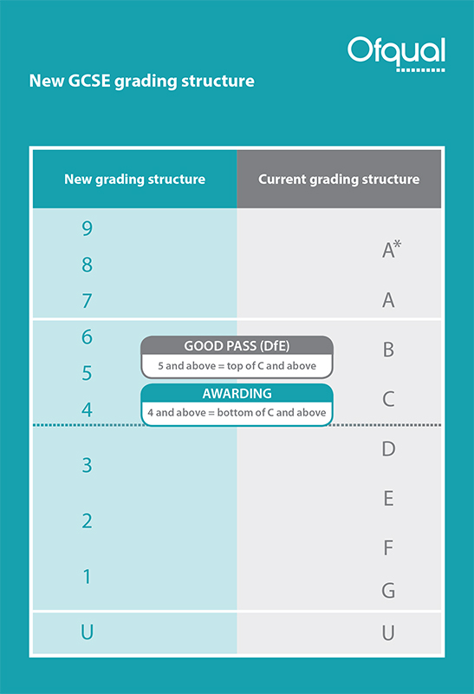
Ian Ramsey CE Academy
Dayspring Trust
“Providing excellent education within a strong Christian community”
Links
New grading
Links

Slide 5
Ian Ramsey CE Academy
Dayspring Trust
“Providing excellent education within a strong Christian community”
Year 11 Results Summer 2018
Maths 5+ 47% English 5+ 65%
Maths 4+ 68.2% English 4+ 81%
9-4 – other GCSEs
Biology 100% Spanish 86%
Chemistry 91% Computing 90%
Physics 100% Geography 60%
RE 75% History 66%
Business Studies 100% ICT User Skills 100%
Music 90% Art 84%
Notes:
German 84% History 76% RE 82% Business 87% Art 95%

Slide 6
Ian Ramsey CE Academy
Dayspring Trust
“Providing excellent education within a strong Christian community”
Year 11 Results Summer 2018
9-7
Maths 16.1% English 20.3%
Computing 30%, Music 40%, RE 30%, Biology 50%,
BTEC Business Studies 41%, Spanish 43%, Physics 38%,
Chemistry 31%
39 pupils (17%) achieved progress deemed ‘Outstanding’ in the Progress 8 measure
26 of them achieving over 1 grade higher than expected across all their subjects
Notes:
German 84% History 76% RE 82% Business 87% Art 95%

Slide 7
Ian Ramsey CE Academy
Dayspring Trust
“Providing excellent education within a strong Christian community”
Why encourage your child to revise?
Reduces panic, gives them control and confidence
Exams reflect what they can do, not what they didn’t bother to do!
Encourages the mind set that hard work pays off – employability skills will make the difference in the future
Revision extends learning beyond the classroom and helps you to know your child’s particular strengths and difficulties

Slide 8
Ian Ramsey CE Academy
Dayspring Trust
“Providing excellent education within a strong Christian community”
Online Learning
All pupils have access to their school email and timetable through Office 365.
This also gives access to the latest Microsoft applications so that pupils can complete their school work on their home computer or tablet.

Slide 9
Ian Ramsey CE Academy
Dayspring Trust
“Providing excellent education within a strong Christian community”
Online Learning
Pupils (and parents) can keep track of homework tasks and deadlines via the Class Charts apps
Differentiated Science activities with hints and instant feedback
RE and Geography resources including chapter overviews, worksheets, self assessment and animations

Slide 10
Ian Ramsey CE Academy
Dayspring Trust
“Providing excellent education within a strong Christian community”
An online platform for all year groups to help you learn, practice and revise Maths
Over 800 ‘skills’ each with their own video and quiz
Teachers can see everything the pupils do
Students can complete as much as they want!

Slide 11
Ian Ramsey CE Academy
Dayspring Trust
“Providing excellent education within a strong Christian community”
Survival guides

Slide 12
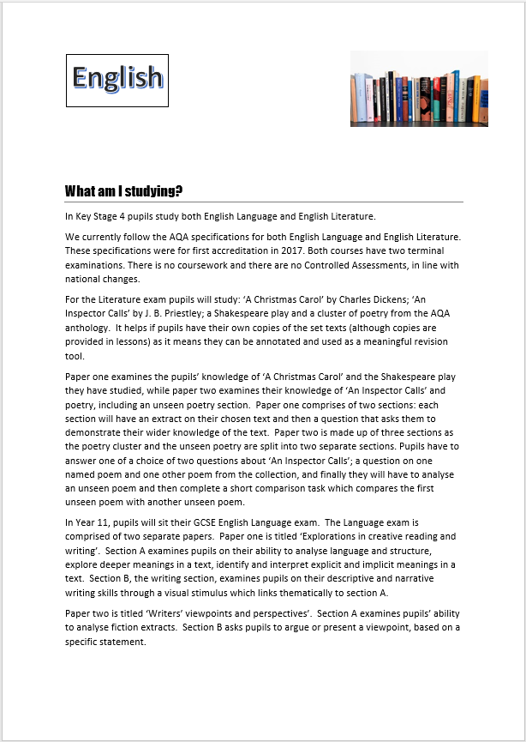
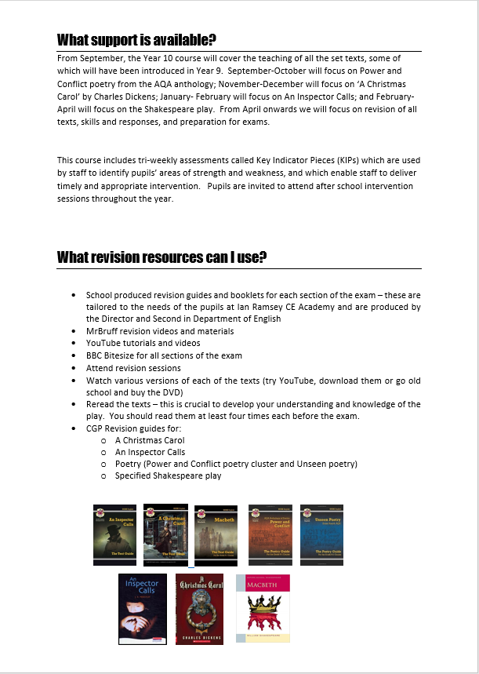
Ian Ramsey CE Academy
Dayspring Trust
“Providing excellent education within a strong Christian community”
Survival guides

Slide 13
Ian Ramsey CE Academy
Dayspring Trust
“Providing excellent education within a strong Christian community”

Slide 14
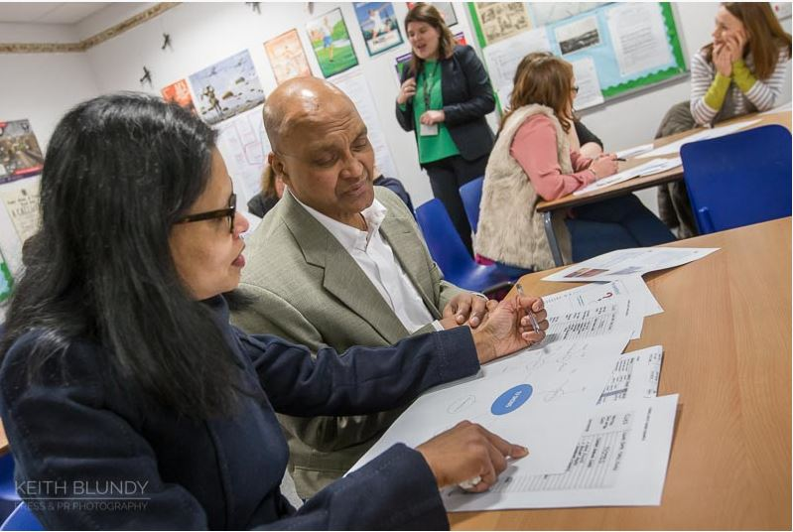
Ian Ramsey CE Academy
Dayspring Trust
“Providing excellent education within a strong Christian community”
Parent Revision sessions

Slide 15
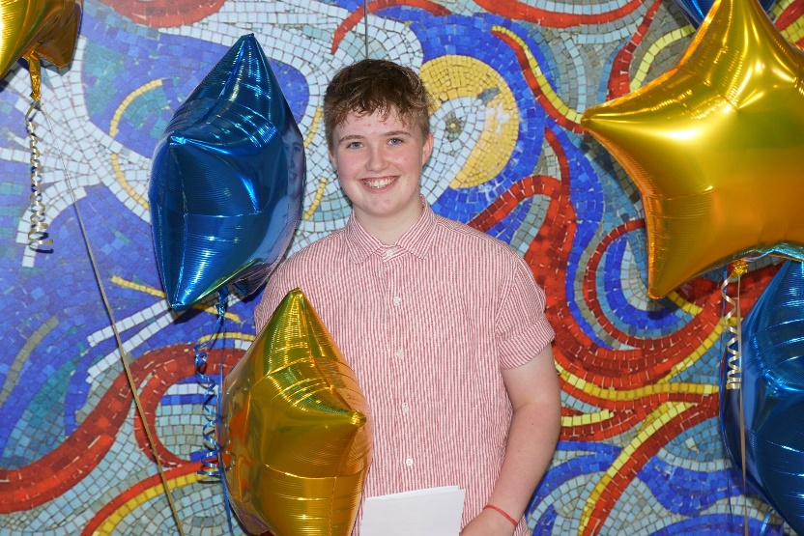
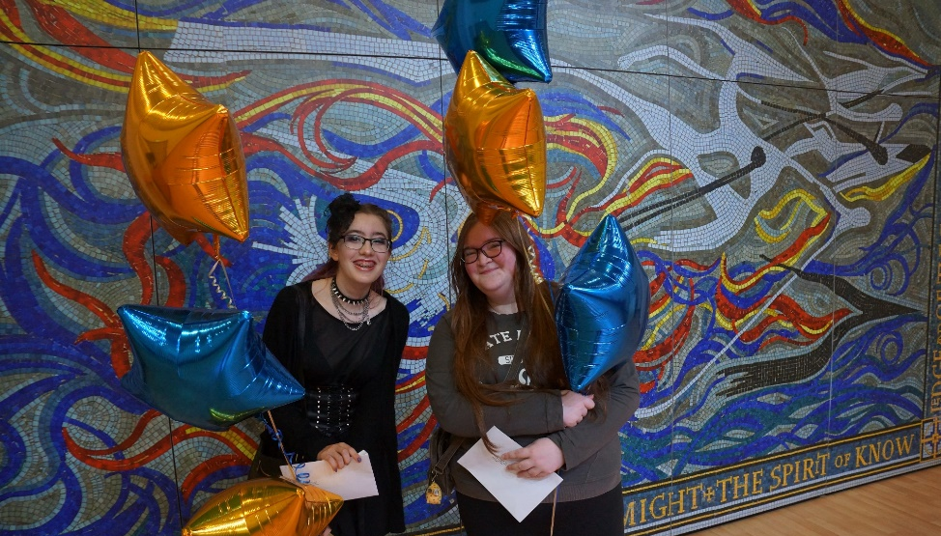
Ian Ramsey CE Academy
Dayspring Trust
“Providing excellent education within a strong Christian community”
Changes to the English syllabi

Slide 16
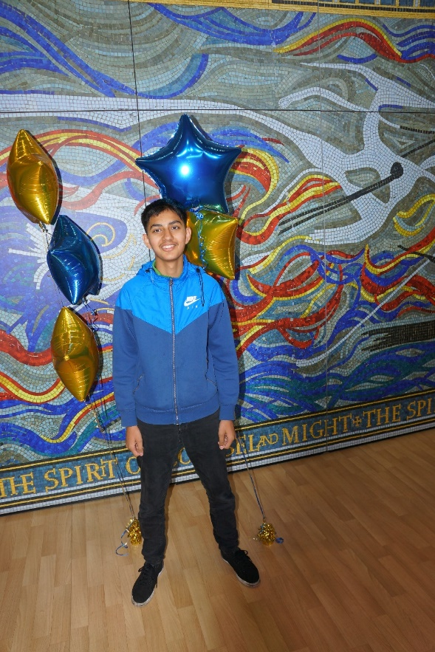
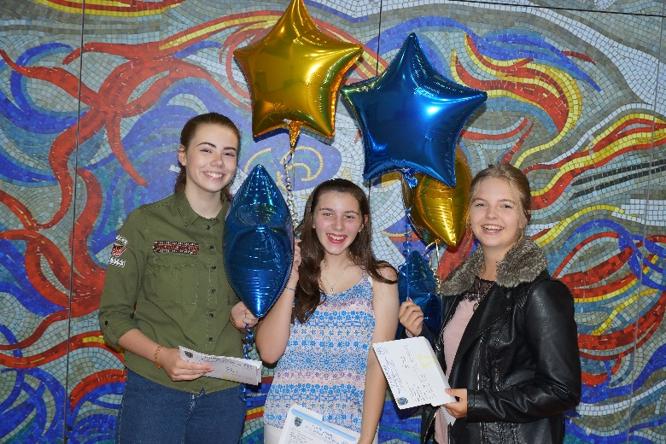
Ian Ramsey CE Academy
Dayspring Trust
“Providing excellent education within a strong Christian community”
Changes we made

Slide 17
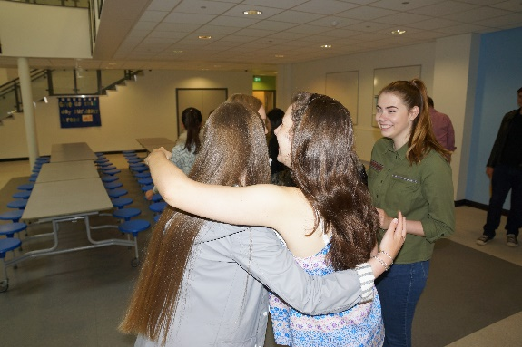
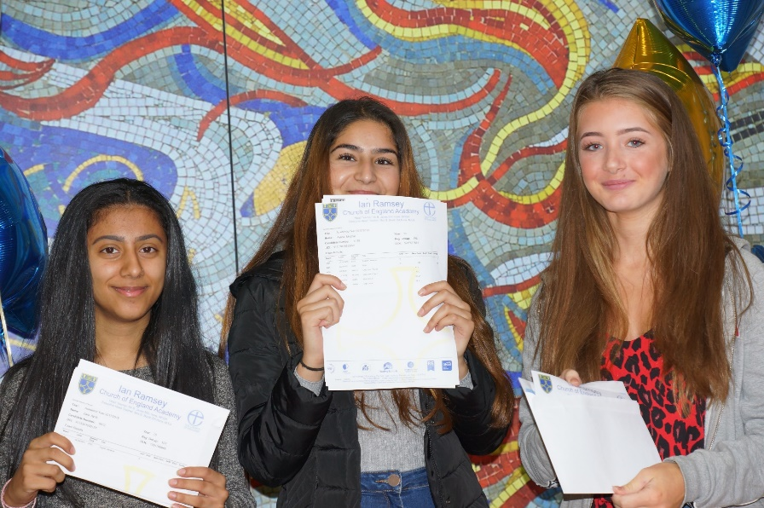
Ian Ramsey CE Academy
Dayspring Trust
“Providing excellent education within a strong Christian community”
The impact they had

Slide 18
Ian Ramsey CE Academy
Dayspring Trust
“Providing excellent education within a strong Christian community”
English Literature GCSE
The English Literature course consists of five units:
Shakespeare (‘Macbeth’)
19th Century text (‘A Christmas Carol’)
Modern text (‘An Inspector Calls’)
AQA poetry cluster (15 poems to be learned)
Unseen poetry

Slide 19
Ian Ramsey CE Academy
Dayspring Trust
“Providing excellent education within a strong Christian community”
What will we do?
Deliver high quality teaching and learning opportunities.
Create bespoke revision materials.
Offer intervention.
Host intensive revision on the morning of the exams.
Provide any other support required to meet individual needs.

Slide 20
Ian Ramsey CE Academy
Dayspring Trust
“Providing excellent education within a strong Christian community”
What do we expect students to do?
Engage in all lessons and interventions on offer.
Be prepared - both materialistically and mentally.
Respond to all feedback given and act upon it.
Meet deadlines.
Complete own revision as well as homework.
Read around the topics covered, paying particular attention to the context of the texts.
Be proud of what they achieve and the progress they make.

Slide 21
Ian Ramsey CE Academy
Dayspring Trust
“Providing excellent education within a strong Christian community”
How can you help?
Provide quiet spaces at home to support focused work and revision.
Support the school with maintaining attendance.
Ask questions about texts, characters and themes.
Once a text is studied, watch the film with your child. Again, feel free to ask questions, especially ‘Why did they do that?’.
Support the use of internet resources for revision (Like Mr Bruff on YouTube).
Revision guides and books make great Christmas and birthday presents!!!

Slide 22
Ian Ramsey CE Academy
Dayspring Trust
“Providing excellent education within a strong Christian community”
SEN Pupils
Some pupils who have additional learning needs may have Access Arrangements in their exams.
Extra time
Reader/reader pens
Use of a laptop
Students should be encouraged to make full use of any additional support offered to them.
Please see Mrs Loughlin if you wish to discuss this.

Slide 23
Ian Ramsey CE Academy
Dayspring Trust
“Providing excellent education within a strong Christian community”
Careers education, information advice and guidance (CEIAG) is an essential and statutory part of the support we offer to all pupils at Ian Ramsey CE Academy
The Academy recognises the essential part careers education and guidance can play in helping our young people prepare for the opportunities, responsibilities and experiences of life
New careers programme planned against the Gatsby benchmarks for all year groups
Dedicated Year 10 ‘careers week’ in July (visits to 4 local colleges)
Introduction of new work experience week in July (dates/details TBC)
Dedicated careers email for parent/carer questions (careers@ianramsey.org.uk)
Please contact Mrs McCarthy (AHT) through careers email or mccarthym@ianramsey.org.uk if any further questions

Slide 24
How does attendance affect student performance?
6
100%
0.38 of a grade higher
5
0.3 of a grade lower
0.8 of a grade lower
4
Pupils with attendance over 95% (less than 9 days off)
Pupils with attendance between 90 & 95% (9-17days off)
Pupils with attendance below 90% (over 19 days off)

Slide 25
Punctuality
Pupils should be registered in their form room at 8:40
Form tutors will save register – anyone entering form room after the 8:40 bell will receive a late mark and detention
Side gates are locked at 8:35 – Pupils must enter through community entrance to sign in.
Pupils entering school after 9:00 must enter through community entrance to sign in with a late mark and go straight to lesson 1
If you arrive after 8.40 am but before 9.00am
Same day after school 30 minute detention
If you arrive after 9.00am
Same day 60 minute detention
“Together to learn, to grow, to serve”

Slide 26
Ian Ramsey CE Academy
Dayspring Trust
“Providing excellent education within a strong Christian community”

